Slide 1
Employee Data Analysis using Excel
STUDENT NAME: HARINI.R
REGISTER NO:2213391036286
DEPARTMENT: COMMERCE
COLLEGE: QUEEN MARYS COLLEGE

Slide 2
PROJECT TITLE
Employee Performance Analysis using Excel

Slide 3


AGENDA
Problem Statement
Project Overview
End Users
Our Solution and Proposition
Dataset Description
Modelling Approach
Results and Discussion
Conclusion
3/21/2024 Annual Review

Slide 4

PROBLEM STATEMENT
THIS ANALYSIS HELPS TO FIND EMPLOYEES ACTIVENESS, GROWTH , INVOLVEMENT IN COMPANY AND PROJECTS
YOU CAN ALSO TEND TO SORT THE GENDER AND THEIR CONTRIBUTIONS

Slide 5

PROJECT OVERVIEW
ANALYSISING THE CONTRIBUTIONS OF EMPLOYEE USING CHARTS AND GRAPHS THROUGH
GENDER
ACHIEVEMENTS
ACTIVE STATUS
IT TEND TO DIFFERENTIATE EMPLOYEE BASED ON THEIR SCORE THEY ARE GIVEN RANKS BASED ON THEIR SCORE –HIGH,MED AND LOW RESPECTIVELY
.

Slide 6

WHO ARE THE END USERS?
MANAGER
ORGANISATION
HR
EMPLOYER

Slide 7

OUR SOLUTION AND ITS VALUE PROPOSITION
CONDITIONAL FORMATTNG- TRACE OUT THE MISSING
SORT AND FILTER-REMOVING MISSING
FORMULA- EMPLOYEE INVOLVEMENT
PIVOT TABLE-SUMMARY
GRAPHS-REPRESENTATION

Slide 8
Dataset Description
EMPLOYEE DATA-KAGGALE
26 FEATURES-9 FEATURES
EMP ID NUMBER
NAME
EMP TEXT
PERFROMANCE LEVEL
GENDER
EMPLOYEE RATING

Slide 9

THE "WOW" IN OUR SOLUTION
IT HELP TO SORT THE EMPLOYEE
=IFS(Z8>=5,"very high",Z8>=4,"high",Z8>=3,"med",TRUE,"low")
3/21/2024 Annual Review
9

Slide 10
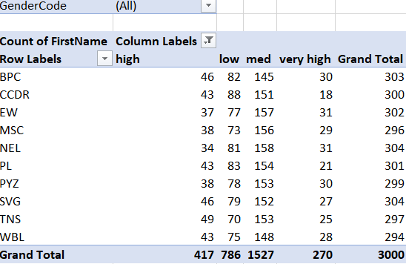
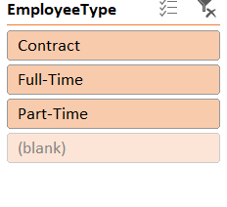
MODELLING
10

Slide 11
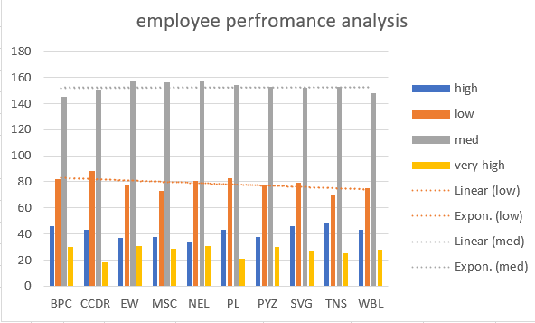
RESULTS
11

Slide 12
conclusion
FROM THE ABOVE SLIDES ABOUT DATA ANALYTICS WITH EXCEL WE CAME TO KNOW ABOUT HOW TO SORT DATA, DATA MANIPULATION, DATA ARRANGEMENT AND MODELLING & RESULTS EXPLAIN US ABOUT THE CONCULSION OF THIS EMPLOYEE ANALYTICS

